Slide 1

Indian Trade Analysis and Forecasting
Project Instructor: Dr. Dalia Nandi, Dept. of ECE
Prepared by
Akarsh Somani(39/CSE/16005/0000162)
Gaurav Misra(39/CSE/16015/0000172)

Slide 2
What is Trade?
Trade is an economic concept which involves Buying and Selling of the commodities, or exchanging goods and services between needy people.
Trade is important in a way that it increases competition and decreases overall world wise cost of a product.
Trade covers for the scarcity of some commodity which may be unavailable in the country in need, like India doesn’t produce petroleum products so we import it from Arab countries.
In exchange, a country can offer to sell commodities which are rich in that country, like India exports metals, pearls, clothes and mineral oils which are scarce there.
So in this way countries help each other and also make some fortune out of resources available.

Slide 3
Significance of Analysis and Forecasting
Country Importing more becomes dependent on other countries thus letting others control their economy.
Country Exporting more becomes stronger economy with the help of profits earned.
Trade Analysis provides a raw understanding of how our country’s economy depends on Imported products. So we can distribute our total import into many countries so that no country can control our economy.
Inflation happens when Import increases and our productivity decreases for the particular product.
Knowing next month’s import value’s increasing trend, we can encourage that commodity’s production to compensate the costs.
Knowing next month’s export value’s increasing trend, we can increase our profits, sensing the more demand from the importing country.

Slide 4
About Data
We scraped the trade dataset from Department of Commerce, Govt. of India website.
Monthly Trade data is available from January, 2006 to January, 2020.
We have total trade amount (Import/Export) for each month which is expressed in million US dollars.
HS Code - Harmonized System (HS) of tariff nomenclature is an internationally standardized system of names and numbers to classify traded products, e.g. 1 for Live Animal, 95 for Toys, Games and Sports Requisites …
Data can be viewed in terms of Country wise or HS code wise.

Slide 5
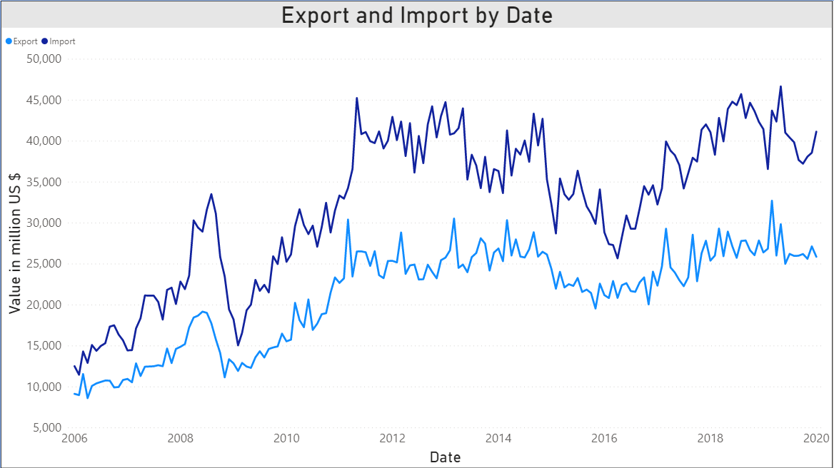
How the Trade Data Looks

Slide 6
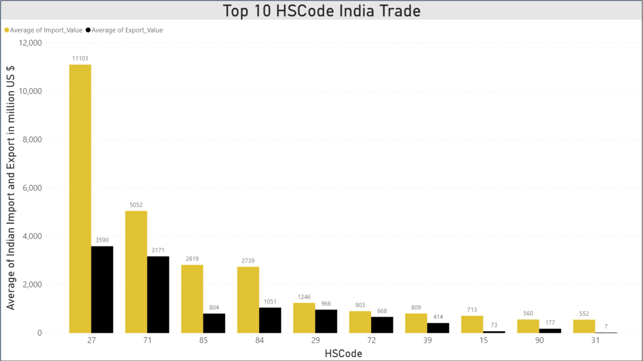
Commodities which we traded the most
27 for Mineral Fuels and Mineral Oils and the product of there distillation.
71 for natural or cultured pearls, precious or semiprecious stones, Pre-Metals, Coins etc.
85 for Electrical Machinery and Equipment

Slide 7
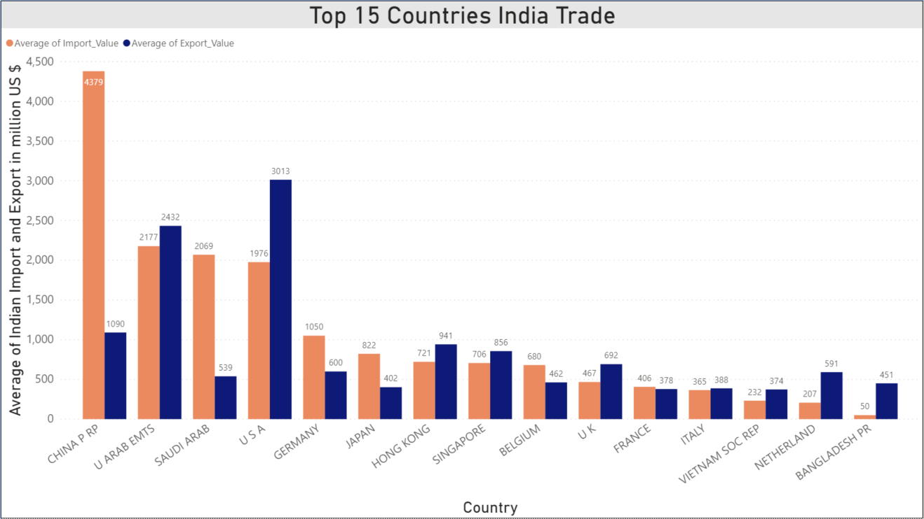
Countries which we traded the most
China tops the list with around $4379 million trade Import followed by United Arab Emirates, Saudi Arab and USA.
While USA is top most country to which India exports the most $3013 million followed by UAE, China, Hong Kong and Singapore.

Slide 8
Models we Used for Forecasting
Exponential Smoothing
Auto Regressive Model
Moving Average Model
Holt-Winters Model
ARIMA Additive
ARIMA Multiplicative
ARIMA Seasonal
RNN → LSTM (Long Short Term Memory)

Slide 9
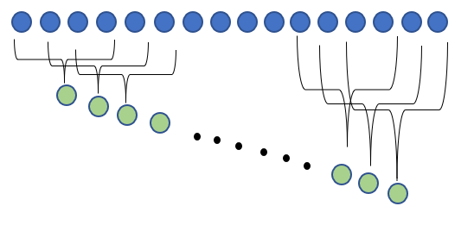
Auto Regressive and Moving Average
AR (Auto Regressive) is used when a value from the time series has dependency on previous values e.g. X_{t} = f(X_{t-1}). The order of an auto-regression is the number of immediately preceding values in the series that are used to forecast the current value e.g. order of 2 denotes that the value X_{t} is dependent on X_{t-1} and X_{t-2}.
MA (Moving Average) is a technique that calculates the overall trend in the dataset. As the name suggest that we go by taking the Average over a fixed rolling size window.

Slide 10
Exponential Smoothing and Holt-Winters
In simple moving average the past observation are equally weighted where as in Exponential Smoothing it exponentially decreases over the time. It has only one smoothing factor.
Holt-Winters is the extension over the simple exponential smoothing method. Here we use triple smoothing with the factor - seasonal period, trend type and seasonal type.

Slide 11
ARIMA – additional and multiplicative
ARIMA stands for Autoregressive Integrated Moving Average which is a combination of three terms –
AR – Auto Regressive
I – Integrated (difference between current values and the previous values)
MA – Moving Average
ARIMA additive –
Additive Time Series = Trend + Seasonality + Randomness
ARIMA multiplicative –
Multiplicative Time Series = Trend * Seasonality * Randomness

Slide 12
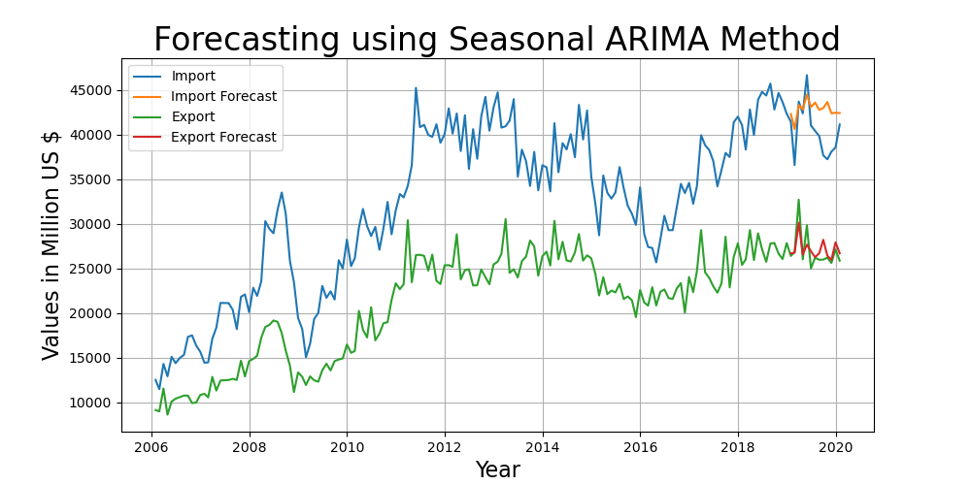
Seasonal ARIMA
Seasonal ARIMA here is ARIMA Multiplicative method with a seasonality factor m. Here we have chosen the multiplicative factor of 12 as ours is a monthly data.

Slide 13

Long Short Term Memory (LSTM)
Recurrent neural networks are used for processing the sequential data, but Unfortunately, as the dependency gets long, RNNs become unable to learn to connect the information.
In these cases, LSTMs come to rescue, which are explicitly designed to avoid the long-term dependency problem.
Remembering information for long periods of time is practically their default behavior.

Slide 14
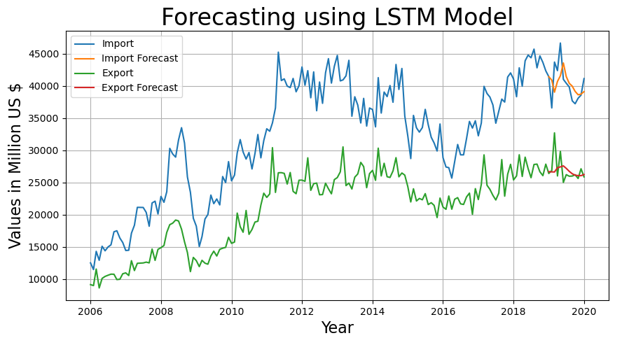
Forecasting using LSTM
We took 12 previous months trade amount as input for our LSTM Model

Slide 15
Comparison of Models
For monthly Import’s data, LSTM stands up to expectations with minimum RMSE of 2637.71
For monthly Export’s data, Seasonal ARIMA outperforms other models with minimum RMSE of 1310.58
Model\Error | Import RMSE | Export RMSE
Exponential Smoothing | 3771.36 | 2042.23
Auto Regressive (AR) model | 2718.07 | 1738.07
Moving Average (MA) model | 7743.73 | 4284.66
Holt-Winters Method | 4417.84 | 1850.49
ARIMA Multiplicative | 3739.46 | 1646.06
ARIMA Additive | 3286.15 | 2026.4
Seasonal ARIMA | 3391.32 | 1310.58
LSTM | 2637.71 | 2043.39

Slide 16
Conclusion
There is an upwards trend in Import forecast and slightly upward trend in the Export forecast.
We’re in huge trade deficit (Export-Import) with China in terms of trade. Hence we need to make strict policies towards Chinese products as soon as possible.
Surprisingly Seasonal ARIMA outperformed LSTM in Forecasting Export Data, which shows that ARIMA captures seasonality much better than any other model, even with lesser data and randomness.
LSTM model performed better for Import Data as expected because of it’s capability of retaining information of long period of time.
LSTM underperformed for Export data because of lesser data and first few unexpected high fluctuations.

Slide 17
Future Prospects
Making Existing Models more robust by tuning them even more.
Using New models specially Attention Models which can even store more information than LSTMs.
Include some factor to encounter the randomness in data which causes high frequency fluctuations which in turn results in below expected performance of models.
Getting more data points for better forecasting specially for LSTM model since it operates on a neural network which needs more and more data for better predictions.
Using this thesis for even more case studies similar to the one we discussed above.

Slide 18
Thank You!

